Slide 1
Earnings and expenses tracker
SAVE MORE FOR BETTER FUTURE
By,
Sruthi Ravula

Slide 2
Project goal
The goal of the project to develop an IOS app for users mainly focusing on travelling business user to track their earnings and expenses which will help the user to keep track of the expenses

Slide 3
Frameworks and tools used
FIREBASE DATABASE
FIREBASE STORAGE
FIREBASE AUTHENTICATION
GOOGLE LOGIN
TESSERACT OCR FRAMEWORK
COREIMAGE FRAMEWORK
SHARE ACTIVITY

Slide 4
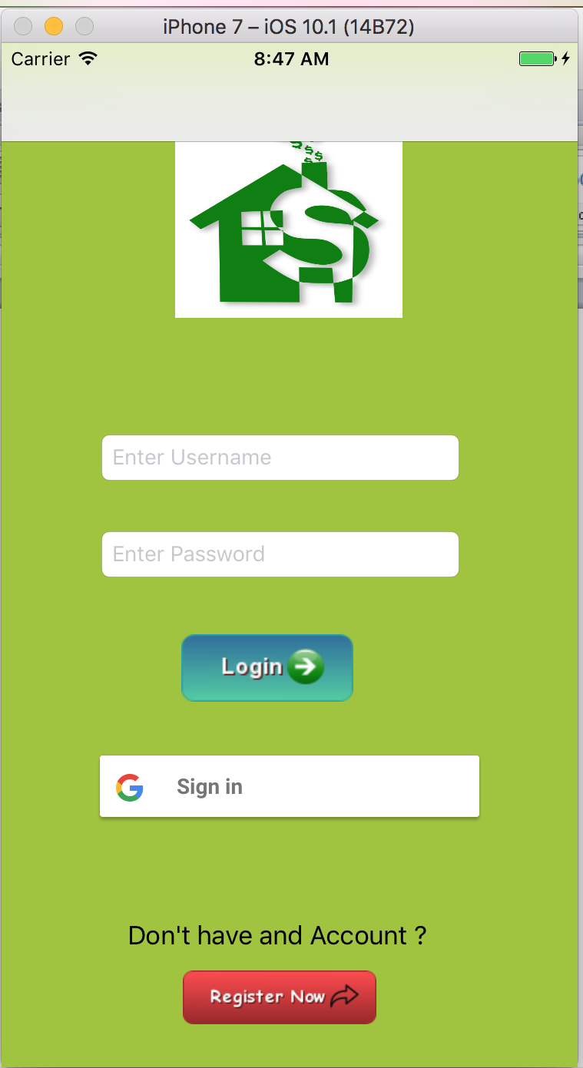
Features – sign up/ Google sign in
User will able to Sign up
User can login using google account.

Slide 5
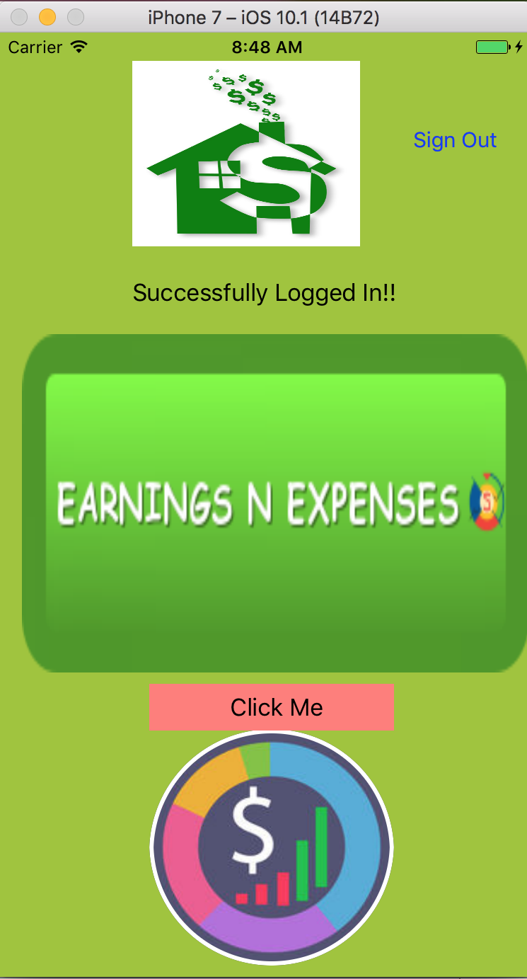

Slide 6
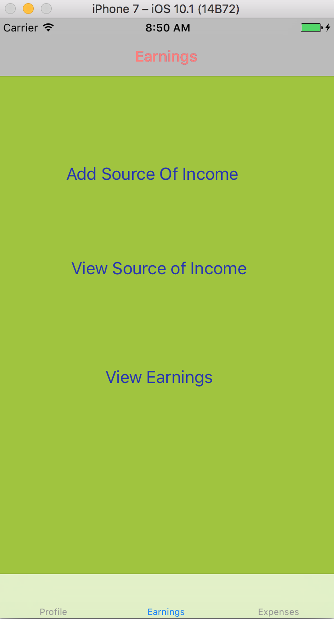
Earnings
User can track earnings from different sources by adding the income earned from each source.
User can view the total earnings.
User can add more source of Income which enable customizable feature to the application

Slide 7
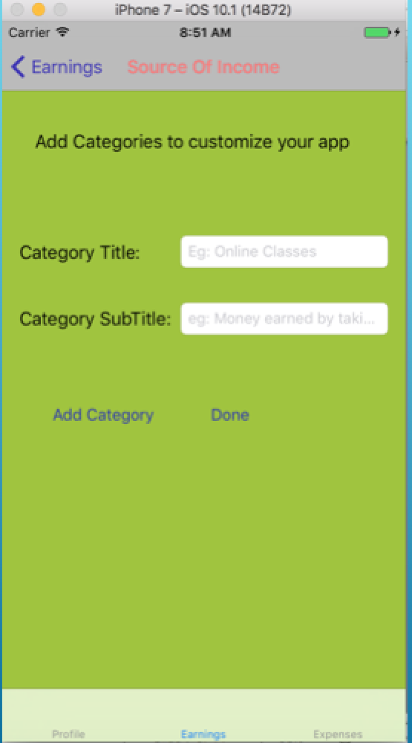

Slide 8
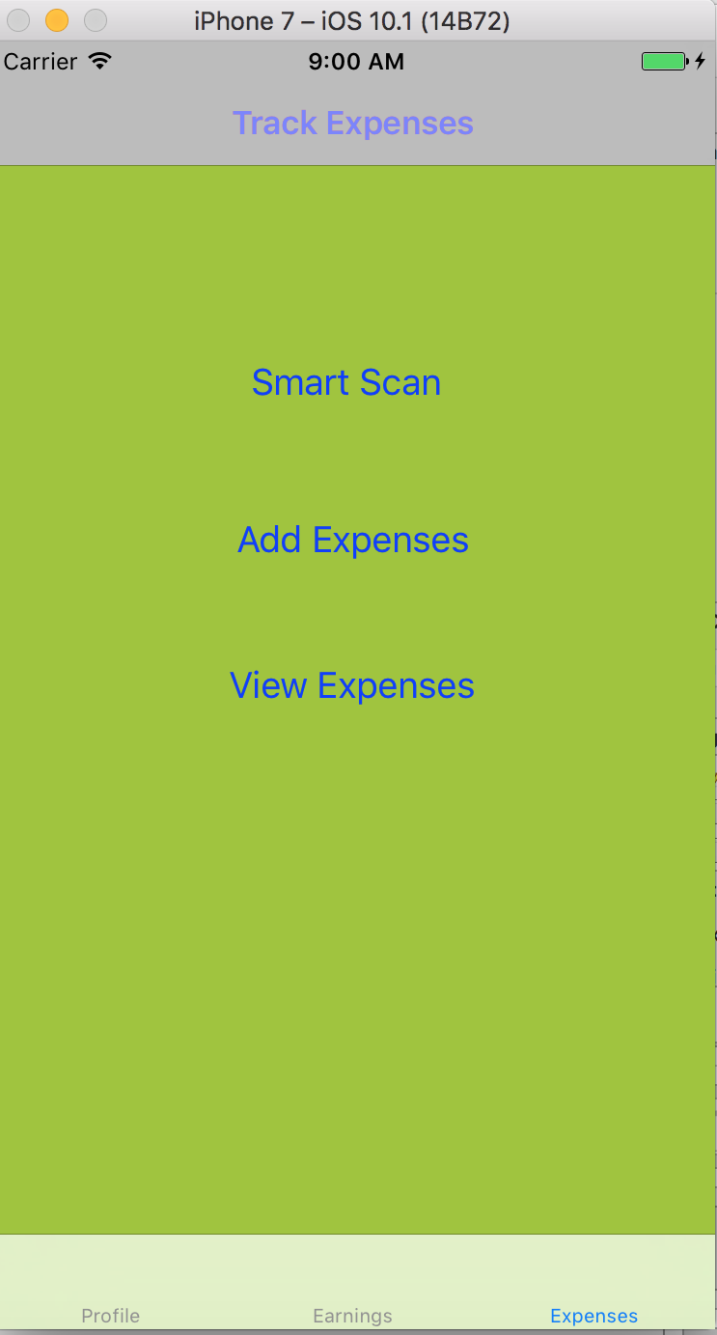
Expenses (personal and business)
User can track personal / business expenses by adding expenses in various categories,
User can view all the expenses or some based on the date
User can share the expenses via mail.

Slide 9
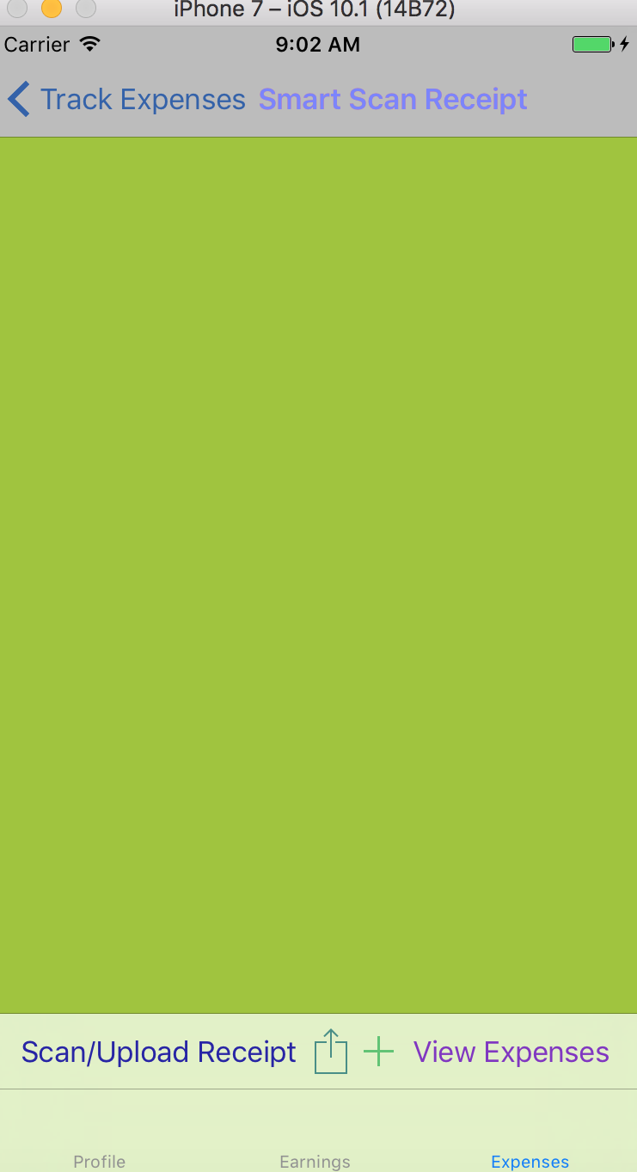
Smart scan

Slide 10
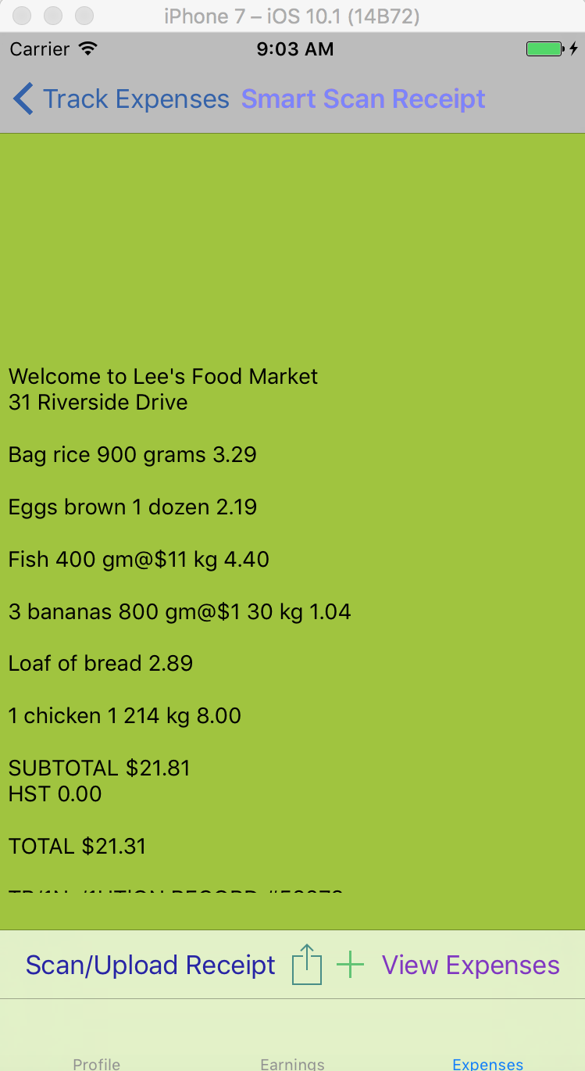
Expenses - smart scan (Tesseract OCR)
User can scan the receipt (eg : grocery receipt) using Tesseract OCR(optical character recognition
Used Tesseract to extract the text from Image ) to auto add the expenses to the category the user prefer

Slide 11
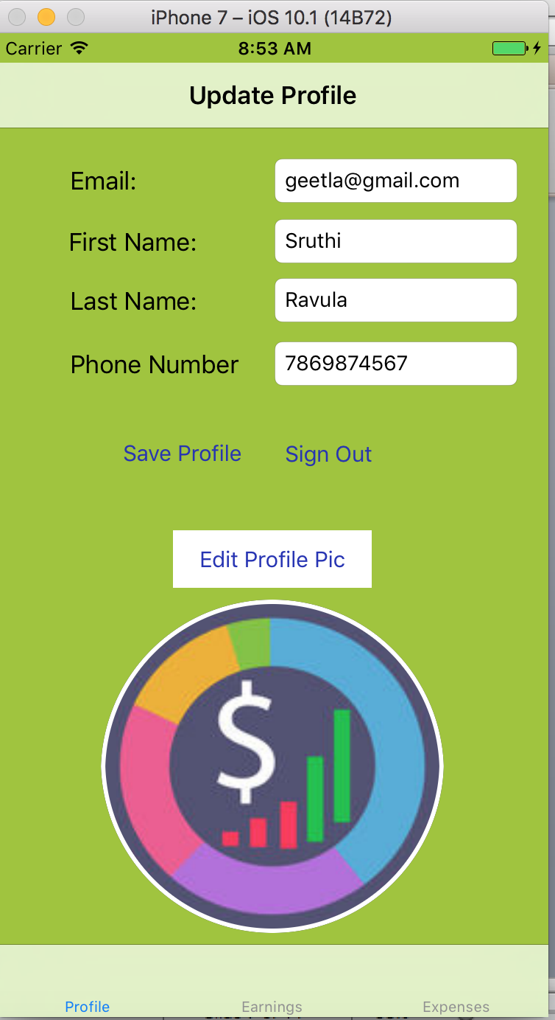
Update profile
User can update Profile

Slide 12
Future extension
Generate Report the Year, Month and by selecting dates
User can share the report via Mail
Integrate with the other business apps like “Concur”
Make the application more customizable by allowing the user to add categories similar to Earnings.

Slide 13
thank you

